Slide 1
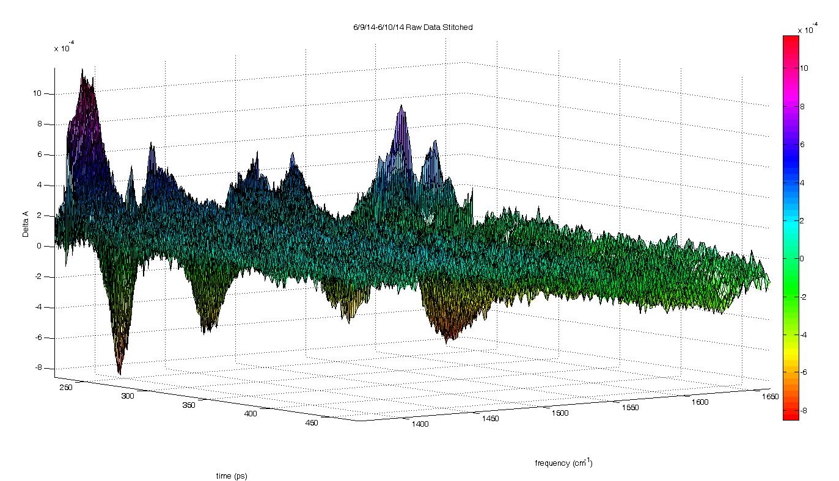
Stitched MetHb Data

Slide 2
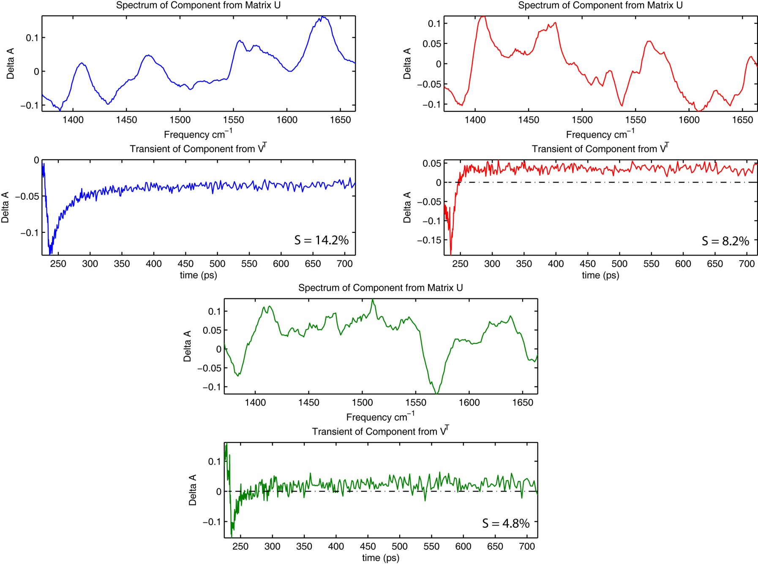
U and V^{T} Components

Slide 3
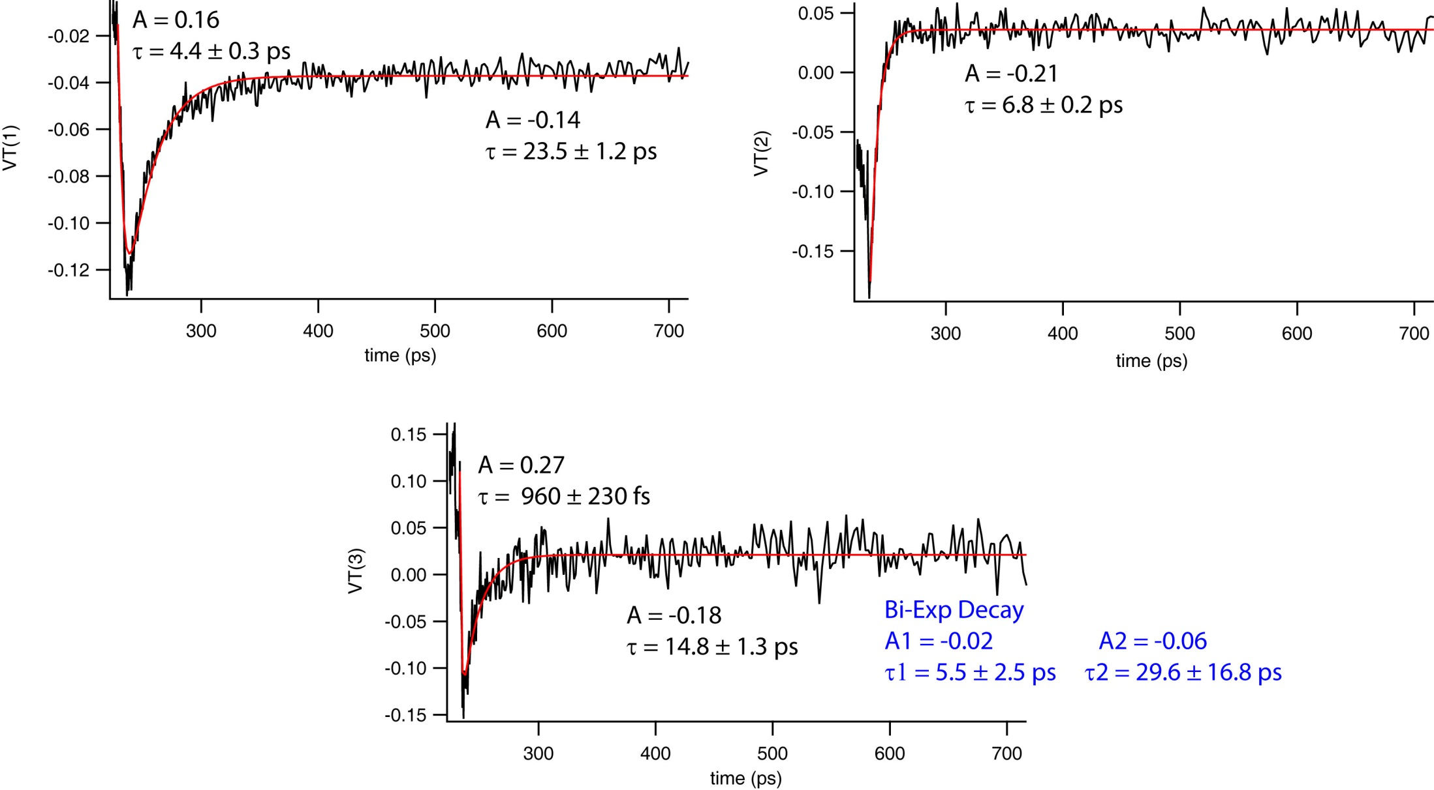
MetHb in D₂O - VT Fitting

Slide 4
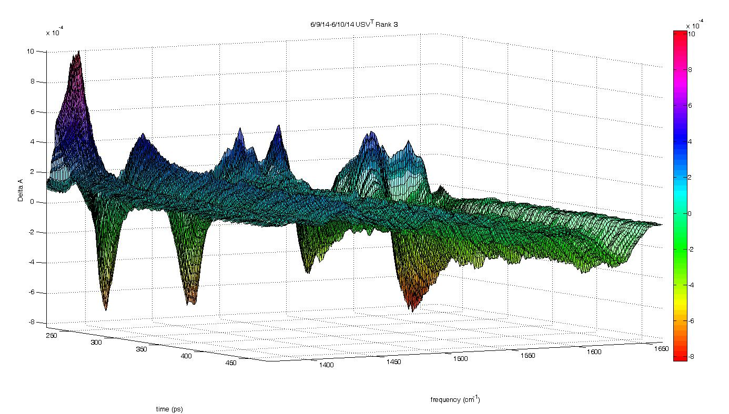

U*S*V^{T} to Rank 3

Slide 5
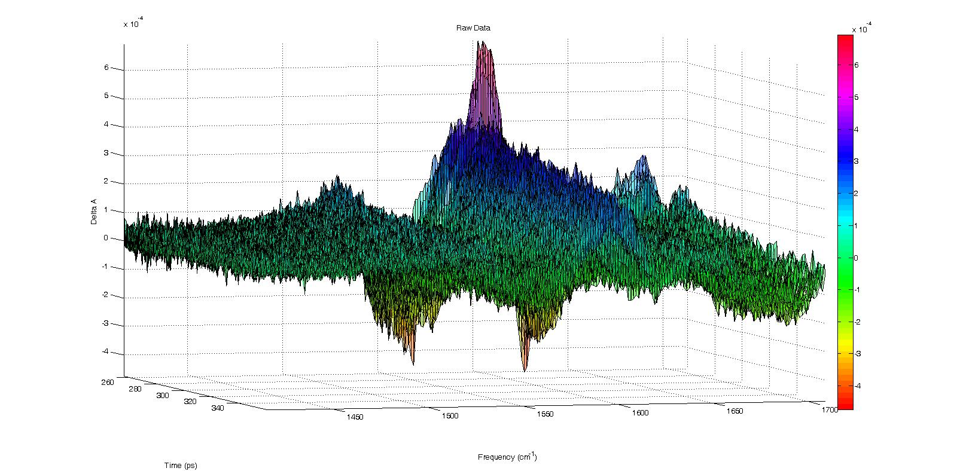
MetHb EG/D₂O Stitched Raw Data
Incomplete Low Frequency Data, only down to ~1420 cm⁻¹
Missing principal heme mode at 1407 cm⁻¹
SVD of whole data doesn’t add anything compared to high frequency half

Slide 6
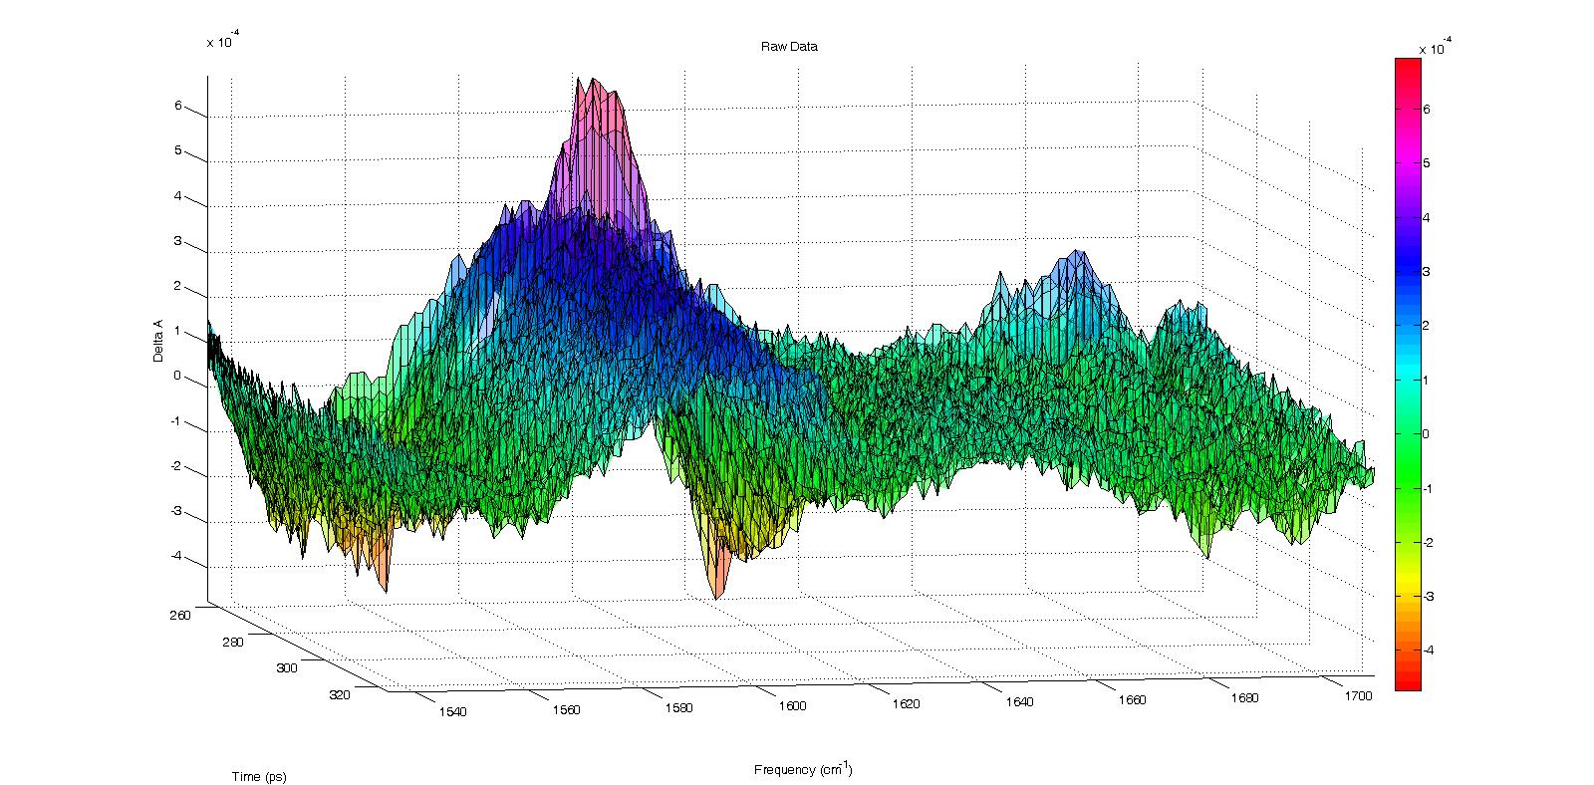
Raw Data: MetHb EG/D₂O 1530-1710 cm⁻¹

Slide 7
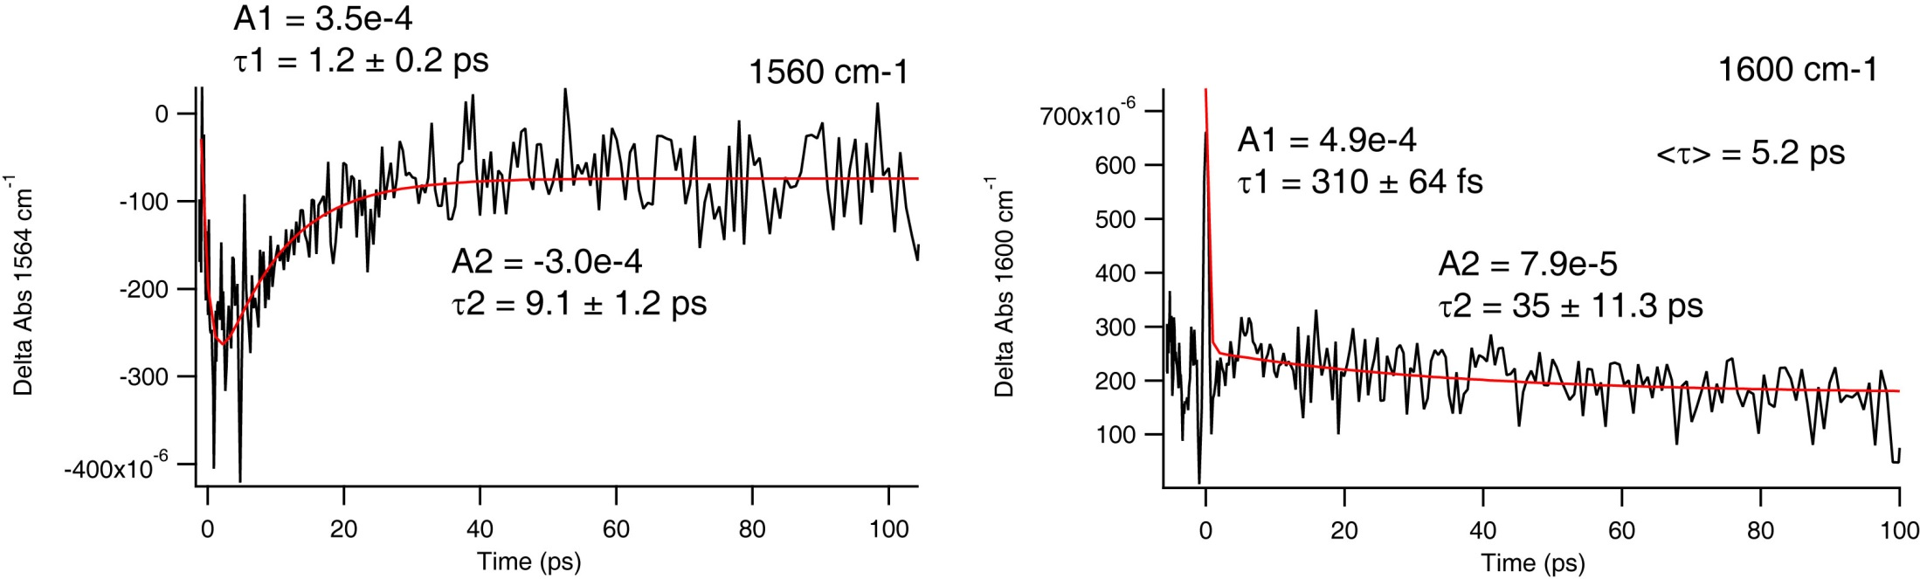
MetHb in EG/D₂O Raw Transient Fits
Transients are noisy, so fits have larger std. dev.
MetHb in D₂O @ 1560 cm-1
same bleach time
faster decay time (~2 ps) but noisier data

Slide 8
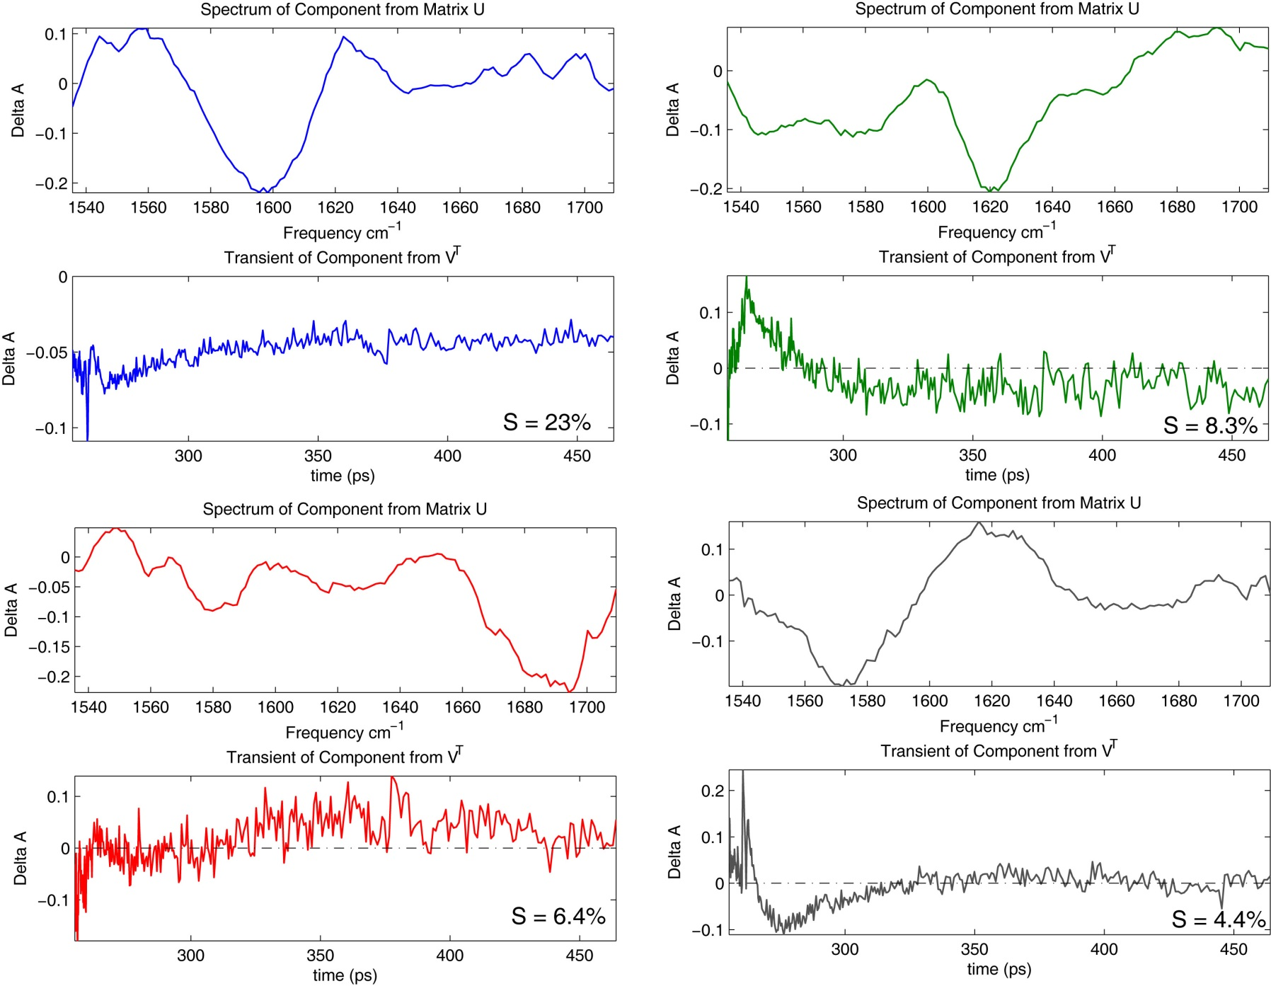
U and V^{T} to Rank 2: MetHb EG/D₂O 1530-1710 cm⁻¹

Slide 9
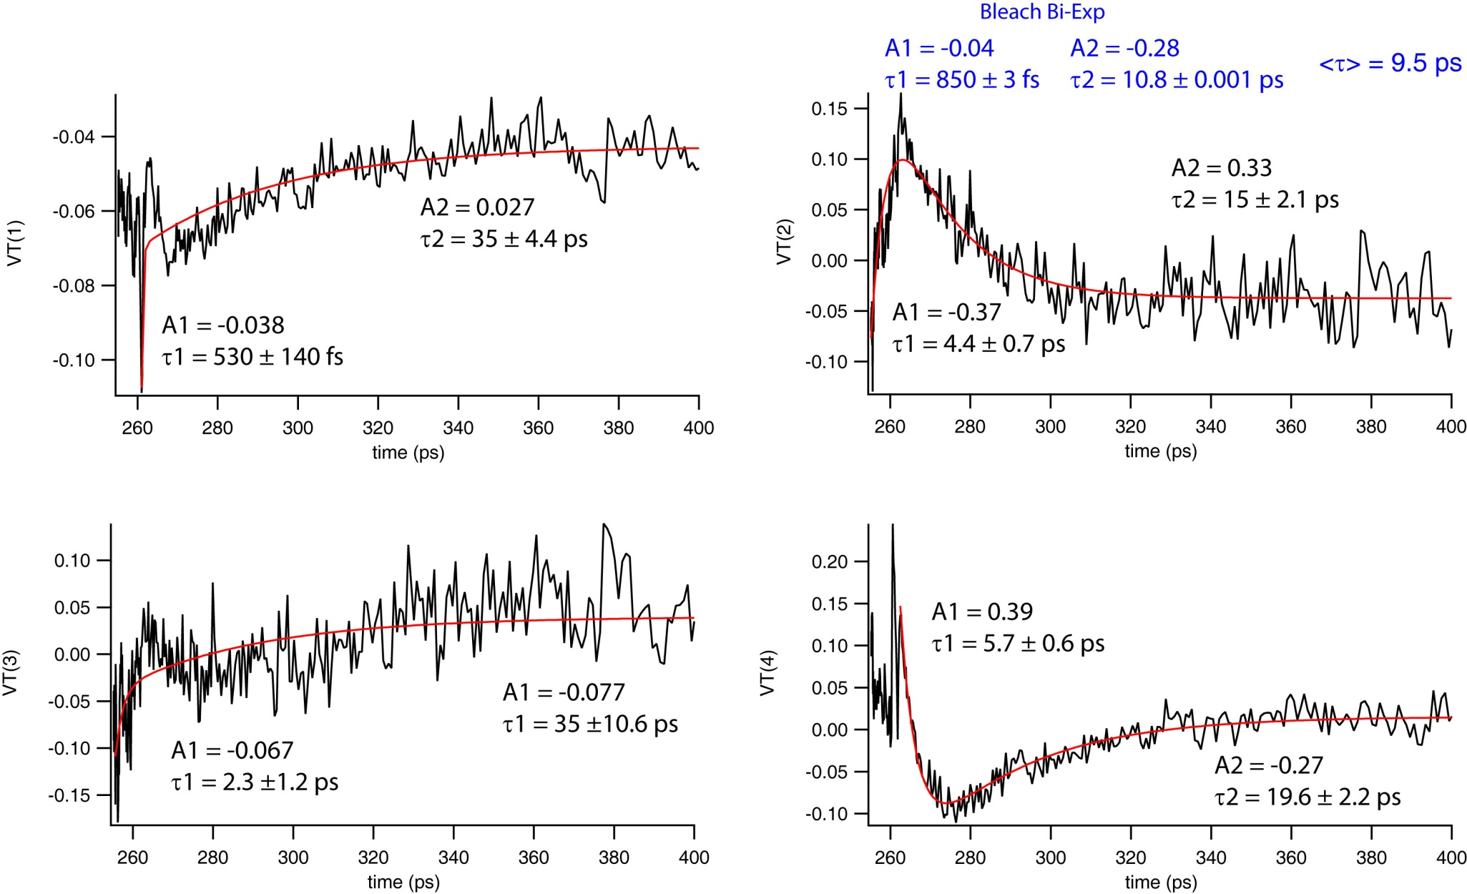
V^{T} Fitting to Rank 4: MetHb EG/D₂O 1530-1710 cm⁻¹
<τ> = 14.7 ps

Slide 10
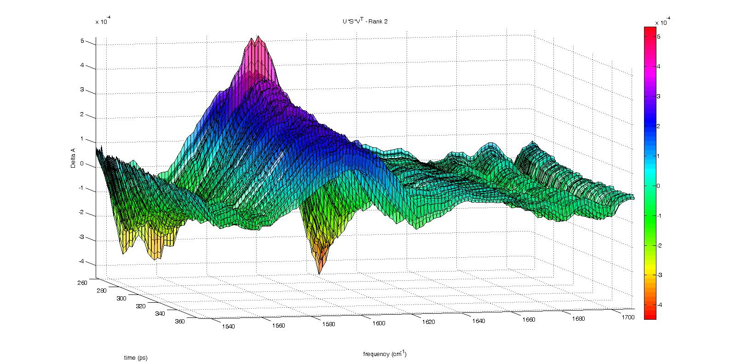

U*S*V^{T}: MetHb in EG/D₂O 1530-1710 cm⁻¹ Rank 2
Comparison to Raw Data

Slide 11
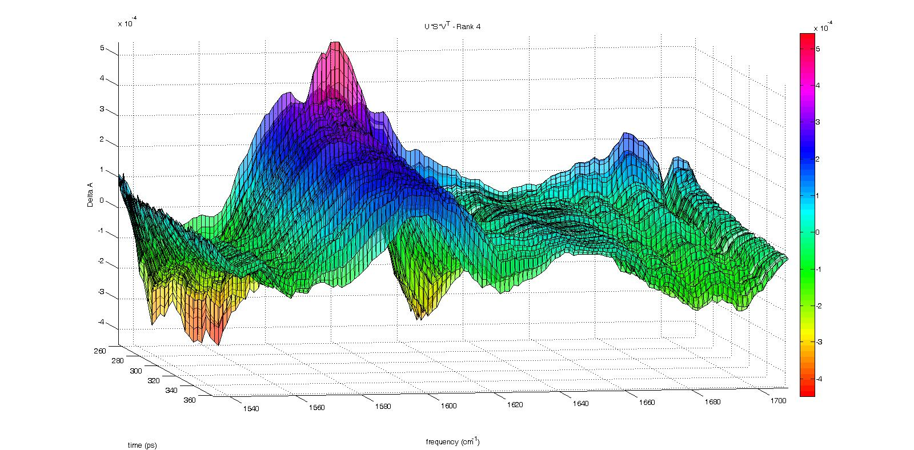
U*S*V^{T}: MetHb in EG/D₂O 1530-1710 cm⁻¹ Rank 4

